Slide 1
Problem Specification
Lecturer: Ngo Huy Bien
Software Engineering Department
Faculty of Information Technology
VNUHCM - University of Science
Ho Chi Minh City, Vietnam
nhbien@fit.hcmus.edu.vn

Slide 2

Objectives
To create product requirements document.
To create a domain model.
To create a product backlog.

Slide 3

Contents

Slide 4

References

Slide 5
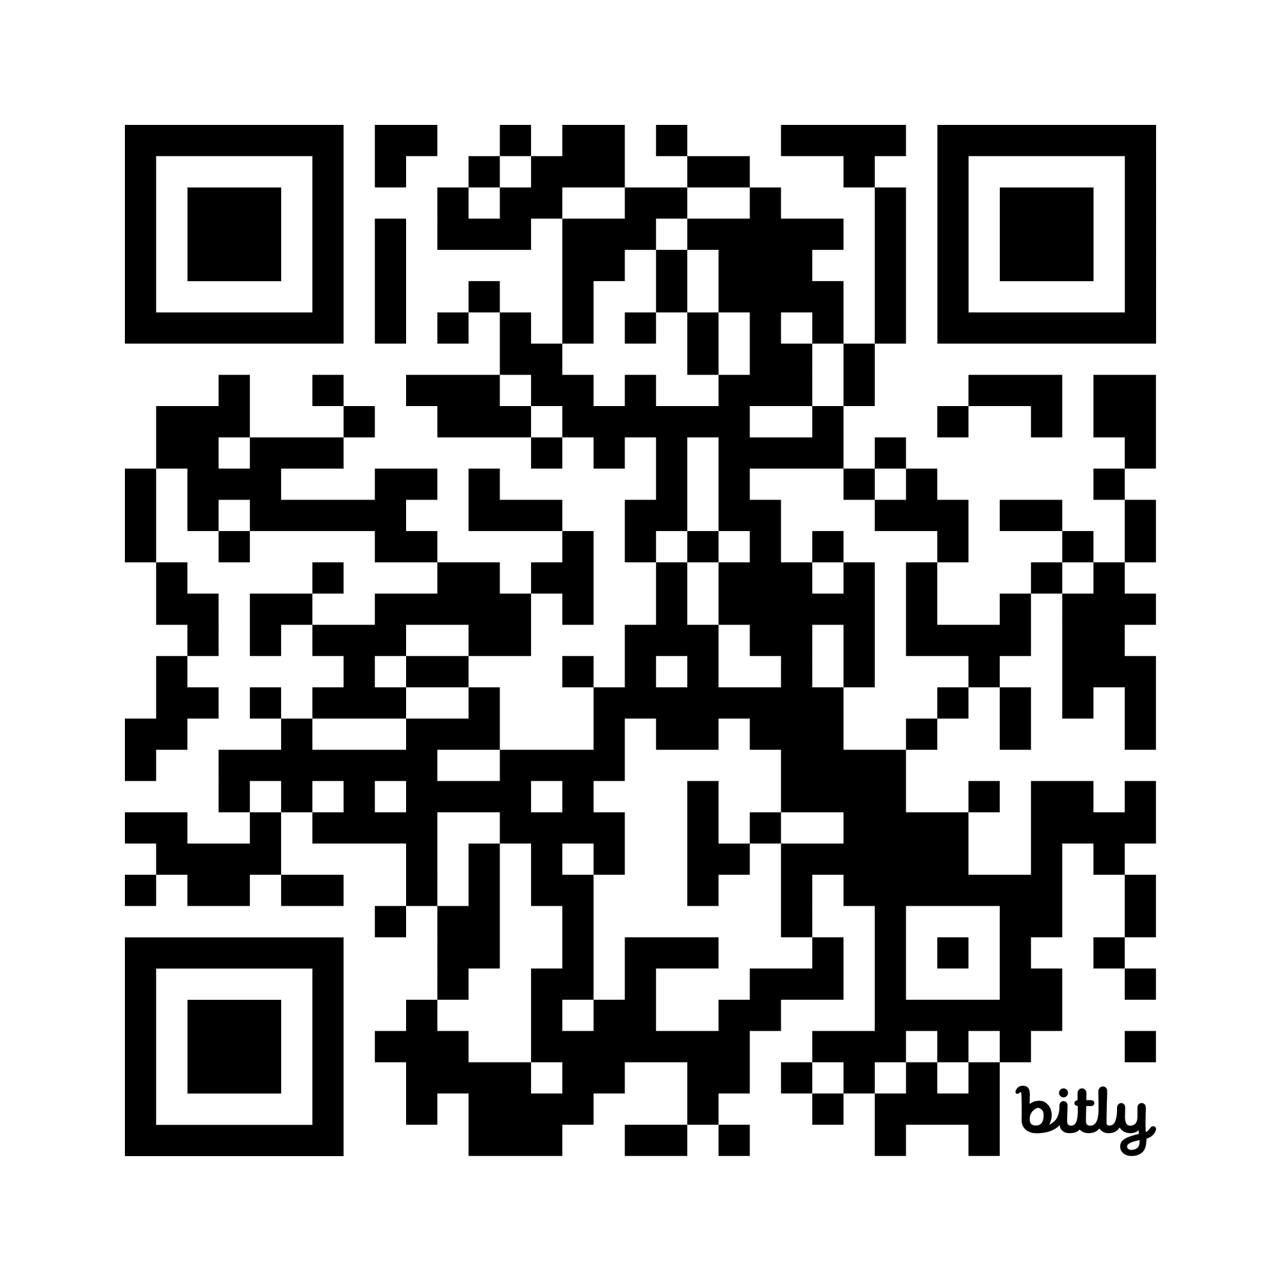

1. Create Statement of Work
https://nhbien.github.io/enterprise-project-artifacts/
https://bit.ly/B22344

Slide 6
2. Review Motivations
The cost of using the existing system is too high.
The data security and privacy measures of the existing system do not meet the specific requirements.
The limitations of the existing system affect cost, work completion time, and user experience.
Workflows or features that users don't like.
Lack of workflows and features that users need.
The system has not been localized for users, or its localization quality does not meet expectations.
The system will be rebuilt primarily for learning purposes.

Slide 7

3. Find a Similar Product
Use the existing product as a user does. Problem: No premium account.
Manage the existing product as an administrator does. Problem: No admin account.
Deploy the existing product as an IT administrator does. Problem: No product deployment package.

Slide 8
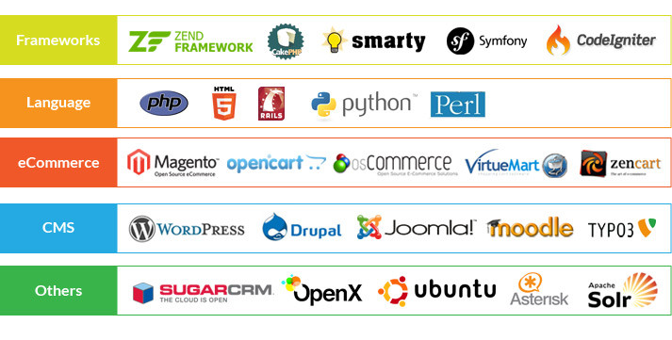
4. Search for Open-source Product
Search for an open-source product.
Deploy and manage the open-source product.

Slide 9
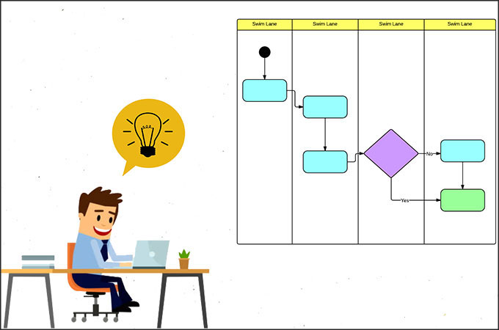
5. Identify Core Workflows
Existing similar system.
Users/ Stakeholders/Roles and corresponding problems.
Cost, time, pain, fatigue, happiness (games).
Users/ Stakeholders/Roles and corresponding goals.
At the first level, the objectives are often expressed by reversing the problem encountered.
Workflow for solving each problem (scenarios/business use case) or achieving each goal.
List: Step 1, step 2, step 3, and so on.
Swim-lane diagram.

Slide 10


6. Identify Manual Workflows
This artifact is optional, but it is often very useful for future validation or improvement of software workflows.

Slide 11

7. Create a Domain Model
Inputs: Domain terms, domain knowledge, workflows.

Slide 12

8. Create a Product Backlog
User story: As a __ I want __ so that __
Based on the workflows, list the proposed features to be implemented.
Each proposed feature should always answer the following questions:
Which step in the workflow is this feature for?
What goal does this process aim to achieve or what problem does this goal aim to solve?

Slide 13
9. Review the Problem Specification
BA/Product Owner
Now | Now | Future
What: domain model (without software) | What: domain model (with/without software) | What: domain model (with software)
How: Scenarios (without software) | How: Scenarios (with/without software) | How: Scenarios (with software)
What: Real world | What: Similar software | What: Product backlog, Software requirements specification
Validation | Evaluation | Verification
 |  | Our software

Slide 14

Thank You & See You Again

